Slide 1
Customer segmentation
Dzheparov Daniil Erokhina Vladislava Lashkevich Elizaveta Okhapkina Arina

Slide 2

Agenda
Cohorts and data analysis
KPI and hypotheses
Cluster analysis and
customer description
Marketing strategy

Slide 3

Cohorts and data analysis

Slide 4
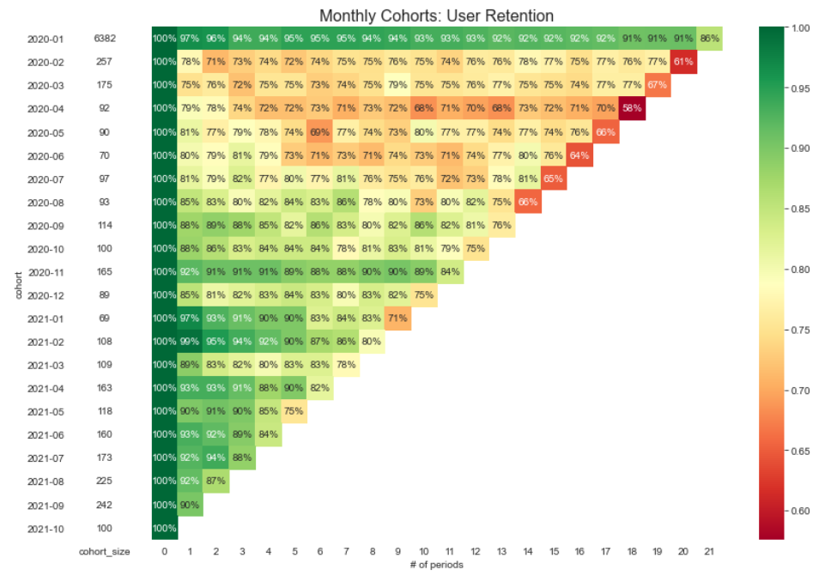
Cohort analysis
Client retention in 2021 has improved
Retention of clients from the 2nd quarter of 2020 is low

Slide 5

Cluster analysis and customer description

Slide 6
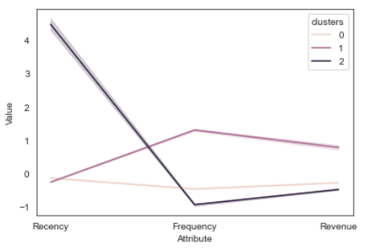
Cluster analysis
Cluster 0: 68% moderate recency, average frequency, average monetary value Cluster 1: 28% moderate recency, high frequency, large monetary value Cluster 2: 4% large recency, low frequency, low monetary value

Slide 7
Customer description
Cluster 0:
Cluster 1:
Cluster 2:
Total 6290
Av. age 43,3
E-mail 14%
Mobile app 21%
Push notification 13%
Phone number 96,6%
Total 2546
Av. age 38,6
E-mail 28%
Mobile app 38%
Push notification 25%
Phone number 96,9%
Total 355
Av. age 48,5
E-mail 20%
Mobile app 20%
Push notification 13%
Phone number 94,9%

Slide 8

KPI and hypotheses

Slide 9
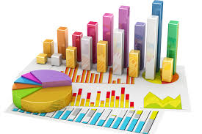
KPI
KPI | Direction | Cluster
Frequency | Increase | 0
Frequency | Maintain | 1
Frequency | Increase | 2

Slide 10


Hypotheses
H0: Push notification do not affect the frequency of purchases (Pearson)
H0: Mobile application does not affect the frequency of purchases (Pearson)
H0: E-mail does not affect the frequency of purchases (Pearson)
H0: There is no statistical difference in the frequency of purchases between groups of people who came recently from those who used the bank for a long time (Kruskal-Wallis)
H0: There is no statistical difference in frequency between customers under and above 40 (Kruskal-Wallis)

Slide 11
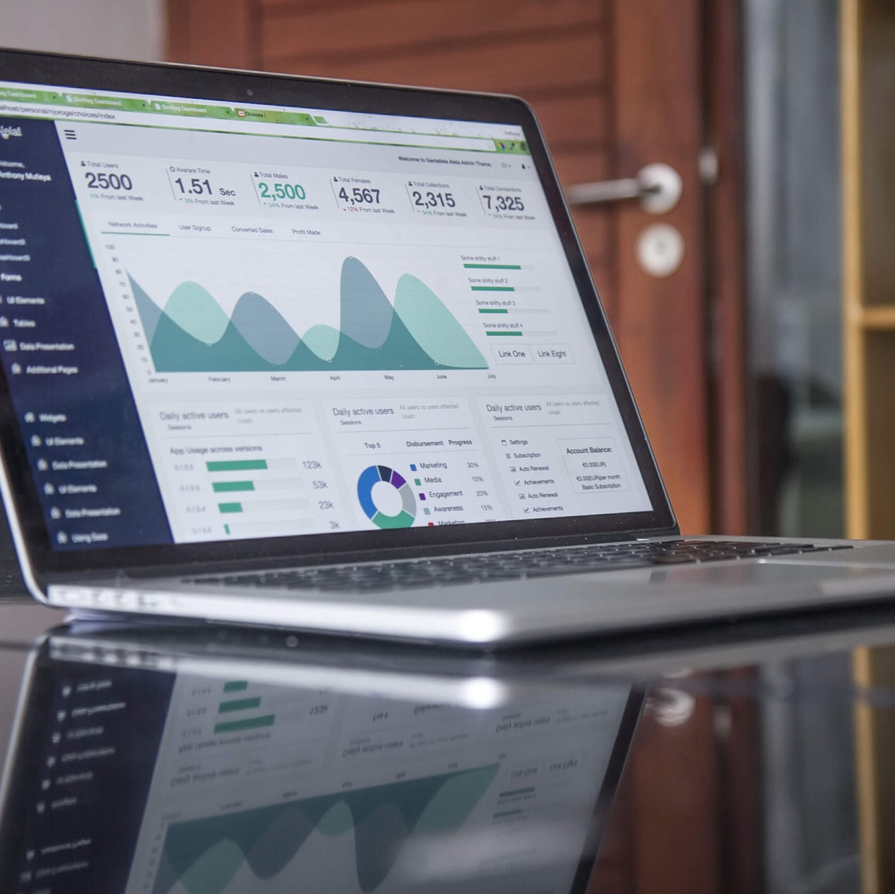
Marketing strategy

Slide 12
Marketing strategy
Cluster 0:
Cluster 1:
Cluster 2:
Communication channel: SMS notification
Offer: Increased cashback for grocery stores and supermarkets in case of installing the application
Communication channel: SMS notification and mobile app
Offer: Increased accumulation of partner bonuses for large spending sum per month
Communication channel: SMS notification
Offer: Special time-limited discounts for partners in case of installing the app during the limited period

Slide 13
Thanks!
Does anyone have any questions?

